Slide 1
Guide to Goal Setting for AD & below career levels
Global Performance Enhancement & Progression
February 2023
Confidential. For internal use only

Slide 2
Contents
Performance touchpoints
Goal Setting Guidelines
For Associates
For Managers
Structure of Goals page explained
Indicative Deliverables for holistic goal setting
System walkthrough – GoPerform
Learning Resources & Support

Slide 3




Our performance process is relevant and helpful
You are here!
You are part of a team
Gain clarity on your role and its expectations
Connect your priorities with that of the organization and team
Your manager and you will discuss the relevant goals and deliverables and document them
You work with your team on a project
Track your progress and showcase achievements
At any point in time, you can review your deliverables, and document notes on the tool
Seek periodic feedback and guidance from your manager, as well as other stakeholders you closely work with.
You have conversations with your manager
Seek feedback and guidance
You receive formal feedback during two checkpoints in the year, Mid-year and Year-end Reviews.
A formal outcome (such as a performance rating) is communicated after the end of each performance year. This rating influences other career experiences such as rewards, progression to the next job in Cognizant.
Your contributions get reviewed and recognized

Slide 4
Goal Setting: Guidelines for Associates
Review your Role & Skill information on MyCareer App (for CCA enabled business units) and update them as required
Be proactive and discuss your focus areas/ deliverables with your Home manager, Business manager & other relevant stakeholders
Ensure your deliverables are specific, measurable and time bound
Include personal, aspirational, social goals that can contribute to your, your team’s and organizational priorities – for example, no. of times volunteered with Outreach programs, contribution to diversity and inclusion initiatives, contribution to team engagement…
Review the deliverables frequently to ensure that they stay relevant to your work and changing business needs

Slide 5
Goal Setting: Guidelines for Managers
Discuss the focus areas/ deliverables for 2023 with your leadership team
Share details of the focus areas/ deliverables with your team members and ensure that they understand how their goals contribute to organizational and team success
Make goal setting process collaborative - involve your team members to identify the focus areas for your team.
Encourage team members to include personal, aspirational, social goals that can contribute to self, team and organizational priorities – for example, no. of times volunteered with Outreach programs, contribution to diversity and inclusion initiatives, contribution to team engagement...
Review the goals frequently to ensure that they are relevant to the changing project needs and business environment

Slide 6
Structure of Goals page explained
Document your goals on GoPerform. The document has three sections.
SECTION 1 | Organizational Metrics
 | Fixed – cannot be modified System tracked at Org Wide Level Customized as per grade/role/BU/region RAG status will be indicated for the goals​ Actuals against targets are refreshed at periodic intervals For example – Learning goals, Productive efforts, TruTime compliance (India)
SECTION 2 | Key Role Outcomes
 | Aligned to Cognizant Career Architecture (CCA) roles ​ Pre-populated based on CCA role & manager can choose KROs relevant to associate​ Minimum of 2 and maximum of 5 KROs can be set
SECTION 3 | Deliverables
 | Key areas of impact/ goals that you will work on Discussed and documented at least twice a year Up to 5 active deliverables at a given point in time – can be added/ modified by your manager and/ or you Periodically add/request notes on your deliverables to update progress or showcase achievements

Slide 7
Indicative Deliverables for holistic goal setting
Build/ Develop my knowledge on Cognizant products, services or processes | Work on an Automation or optimization project within the team/ BU | Ensure 100% compliance to the processes managed | Volunteer for Outreach activities on a regular basis
Ensure I am up to date on organizational purpose, vision and strategy | Create improvement opportunities to increase client satisfaction | Adhere to timelines for all project deliverables with 100% accuracy | Join one or more ally group and participate actively in events and programs
Conduct or attend knowledge/ best practices sharing session for the team on a regular basis | Work on cross entity or cross functional projects to cultivate my collaboration capabilities | Create extensive project plans to provide visibility on accountability, deliverables and timelines | Provide support and guidance to a new joiner or junior associates in team
Enhance my knowledge on client processes/ application or client’s market/ industry | Enhance my proficiency in required technical and/ or professional capabilities | Attend/ Conduct regular connects with team members | Improve my coaching or networking skills through focused actions
In addition to key deliverables related to the role, consider personal, aspirational, social goals, such as no. of times volunteered with Outreach programs, contribution to diversity and inclusion initiatives, contribution to team engagement...

Slide 8
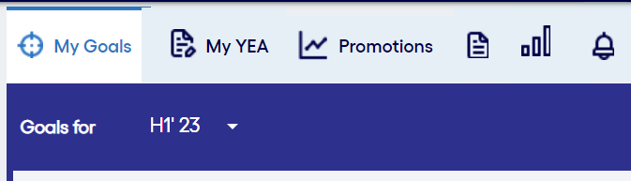
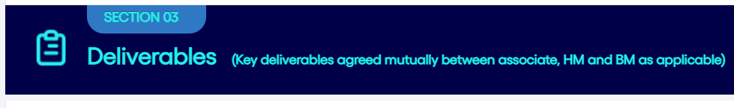
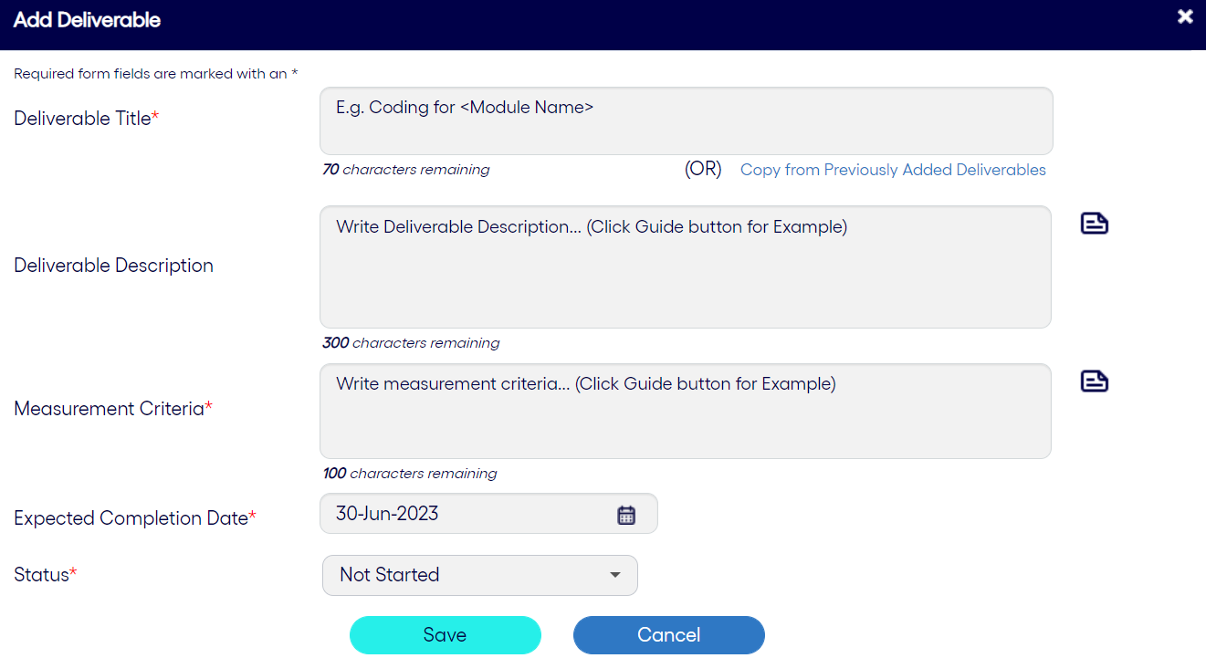
How does an associate set goals on GoPerform?
1
Login to OneCognizant > GoPerform > My Goals*
Review your organizational metrics (refreshed periodically)
View your Key Role Outcomes. Contact your manager for any changes
Managers need to login to GoPerform > My Team > Associate name to access this page for their reportee(s)
System View
2
List the Action items you are working on
Aggregate small tasks and break large projects to achievable milestones
Go to Section 3 – Deliverables
3
Add Deliverables
Click on Add deliverable
Enter the relevant details and click on ‘Save’
And you are done!

Slide 9
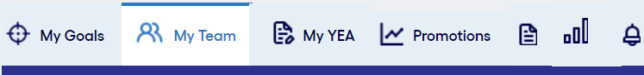
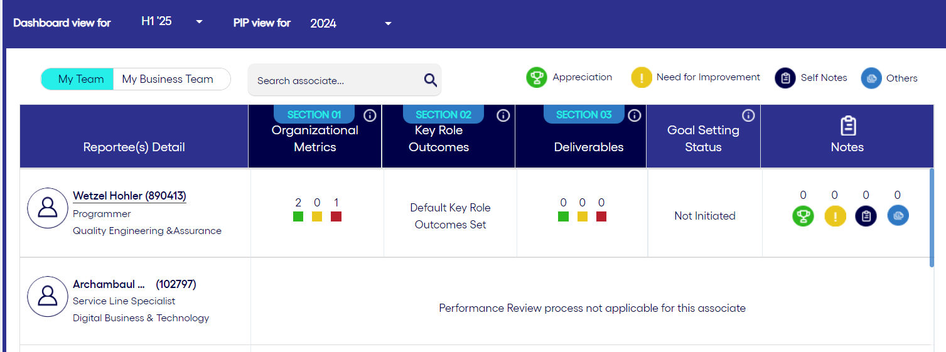
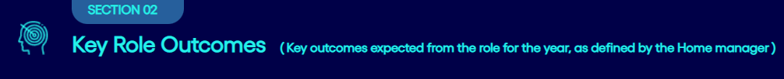
How does a home manager set goals for direct reports?
System View
1
Login to OneCognizant > GoPerform > My Goals*
Review your organizational metrics (refreshed periodically)
View your Key Role Outcomes. Contact your manager for any changes
Managers need to login to GoPerform > My Team > Associate name to access this page for their reportee(s)
2
List the Action items you are working on
Aggregate small tasks and break large projects to achievable milestones
Go to Section 3 – Deliverables
3
Add Deliverables
Click on Add deliverable
Enter the relevant details and click on ‘Save’
And you are done!

Slide 10
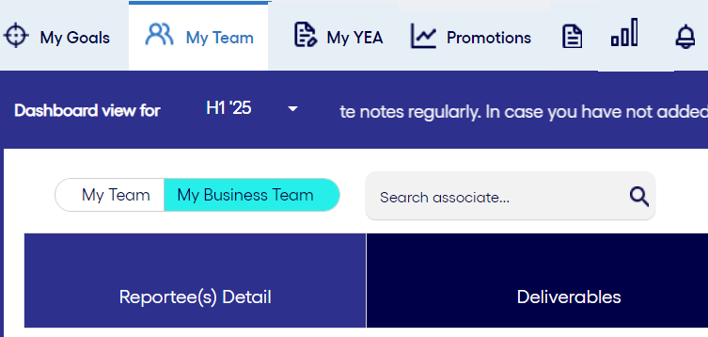
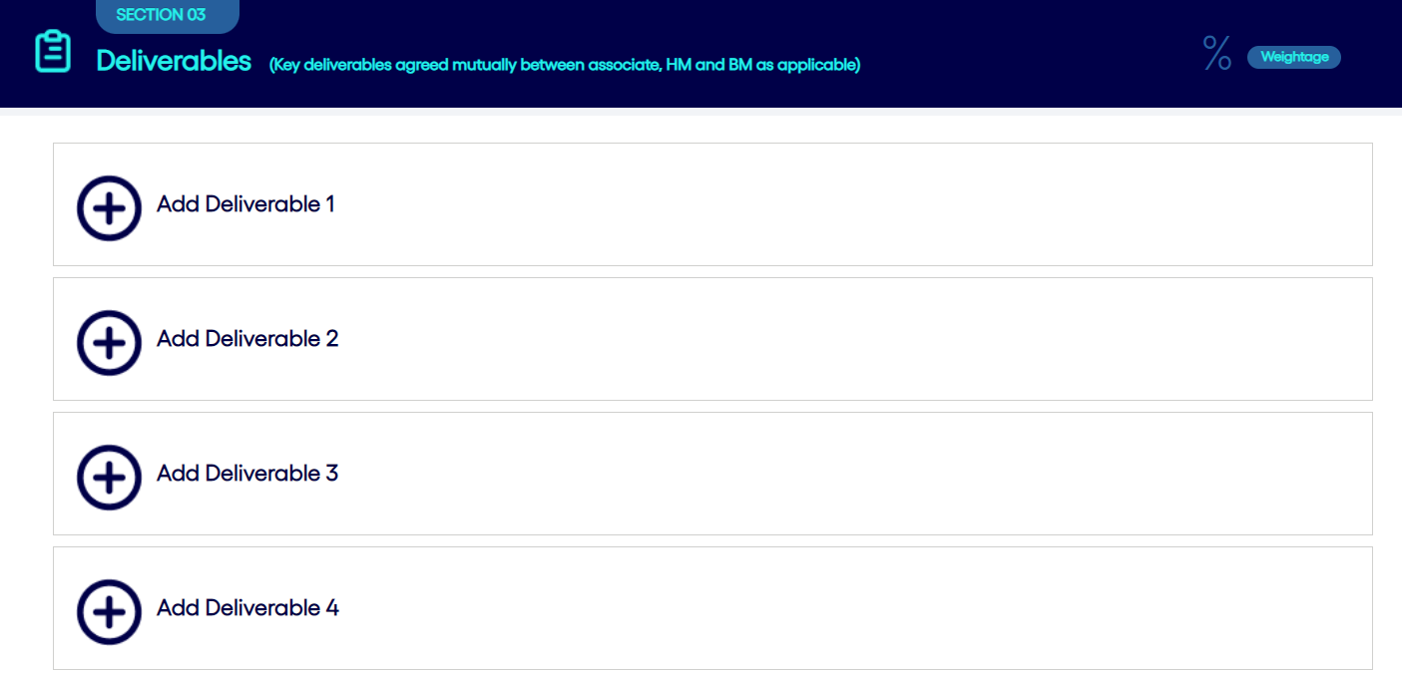
What role does the business manager play in goal setting?
System View
Login to OneCognizant > GoPerform > My Team
Business Manager must set project specific goals in Section 3 of GoPerform for each associate for whom he/ she is tagged as a Business manager in HCM.
Navigate to ‘My Team’ In GoPerform
Select period for which you want to set goals
Select ‘My Business Team’
Select the business report for whom you want to set goals
Click on ‘Add Deliverable’ to add goals
Click on ‘Submit’, and you are done!

Slide 11
Learning Resources & Support
Primary
Reach out to your home manager for any support or clarifications
Training Material
Helpline
Connect for further support
India - 1800-572-0473
UK - 0800-678-1616
US - 1-866-822-2024
What Separates Goals We Achieve from Goals We Don’t
5 Tips to Set Goals that Drive Performance
To Achieve Big Goals, Start with Small Habits
Performance planning through goals – Virtual Instruction Lead (for SM-AD levels)
Training programs:
Chat: Live Support
Talk: GSD numbers
Goal Setting – Virtual Instruction Lead (for M& below levels)

Slide 12
Thank You
Global Performance Enhancement & Progression

